Slide 1
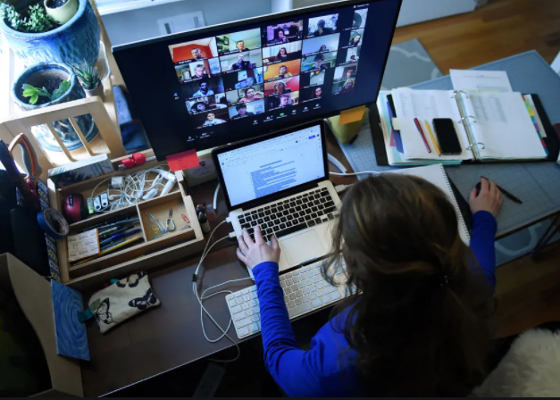

Industry, Academia, and Professional Networks
Stay Connected via MFESTS
STEM Communities – Range of Disciplines
Virtual Networking
Leaderships Opportunities

Slide 2

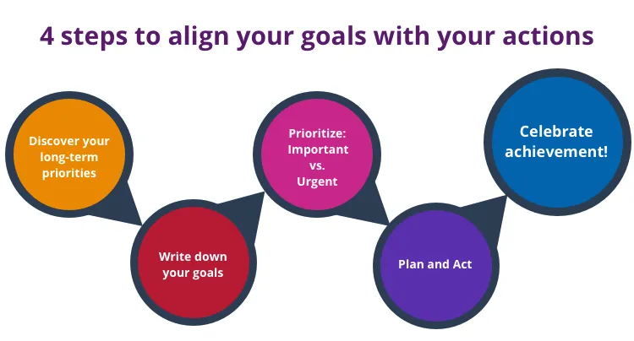
How does this align with our goals?
Outreach –
  Promote mathematics and sciences in secondary schools ie via Future Cities Competition, MathCounts, and other youth-oriented MN State STEM events.
  Assist with "Engineering" curriculum in upper secondary/post-secondary schools.
Partnership/Membership Collaboration –
  Facilitate best practice share and continuing education for professionals.
  Provide people with access to member societies topics in a timely manner.
Executive Committee Leadership –
  Promote professionalism/diversity/inclusion among member societies.
  Recognize the achievements/accomplishments of individuals by way of member society nominations.
  Engage stakeholders.
Our Mission
To provide service to young people in hopes of helping them learn more about potential STEM careers. See Outreach.
To provide professional development services to professionals in engineering-related careers. See Partnerships/Membership Collaboration.
To provide service to member societies (BOD). See Executive Committee Leadership.

Slide 3
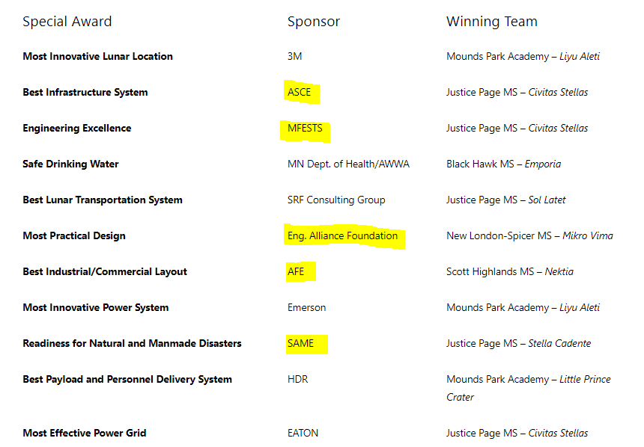
2020-21 Results
21st Annual (1st Virtual)
19 Teams
10 Middle Schools
MN Future Cities Competition
MFESTS Outreach via
Engineering Excellence (Since 2004)
Awarded to the city that best integrates
the use of many different engineering disciplines,
uses creative and practical engineering solutions, and plans for future growth.
3

Slide 4
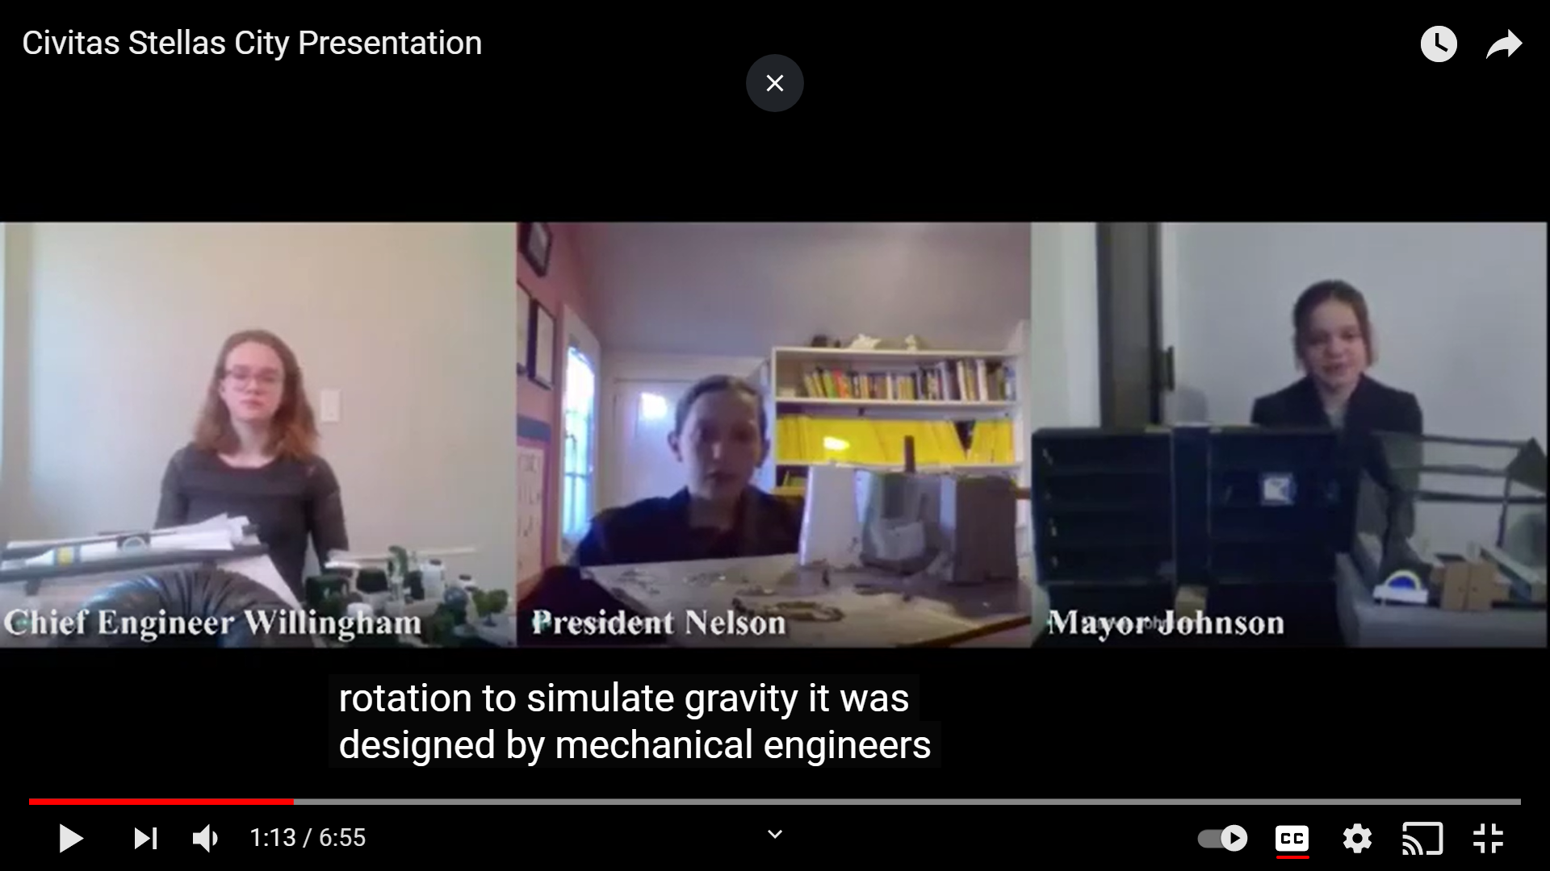
Large image
2021 Virtual Future Cities - Civitas Stellas
MFESTS Engineering Excellence
Award Winners

Slide 5
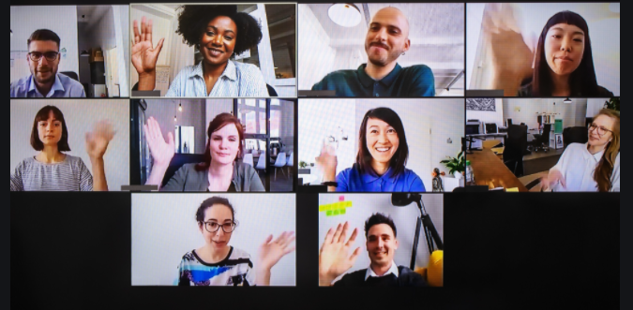

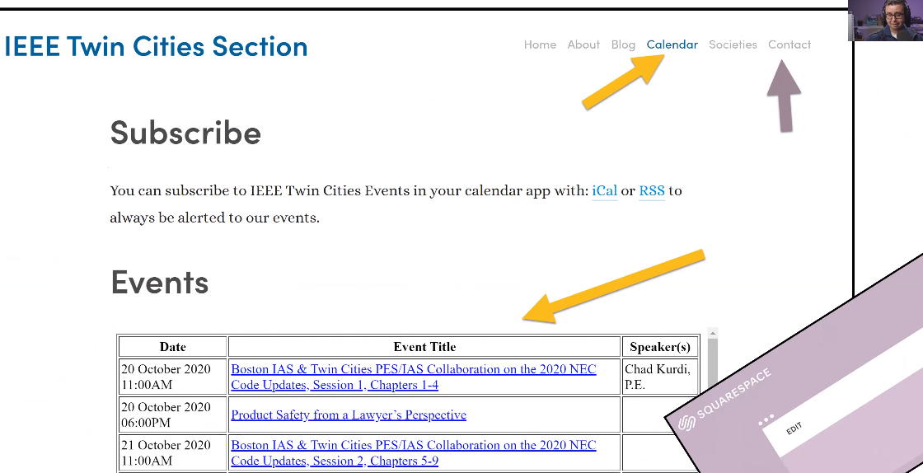
Partnership/Membership Collaboration/Best Practice Share
(Just highlighting a couple examples)
Diversity in Action
  In celebration of Engineers Week and Black History Month, NSBE hosted a joint meeting with INCOSE
  February 19th, 2020
  6:00pm Networking
  6:30pm NSBE Mission/Ice Breaker
  6:45 HR Presentation: Cummins
  7:15 Featured Speaker: Love & Engineering - Alex Merritt
  7:45 Adjourn
Adapting to Virtual Sharing Practices
PE Licensure

Slide 6
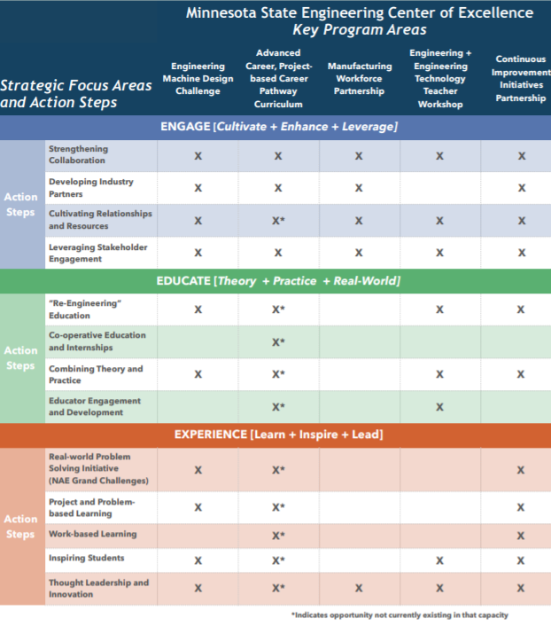
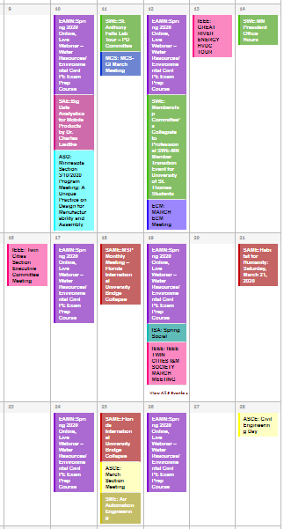
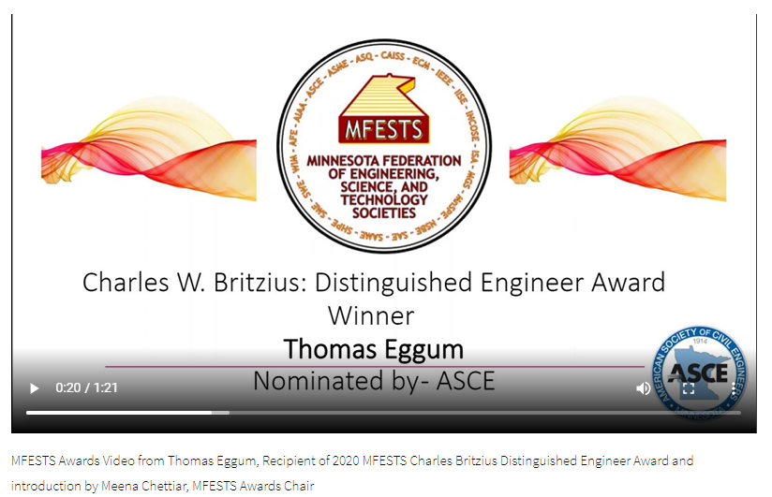
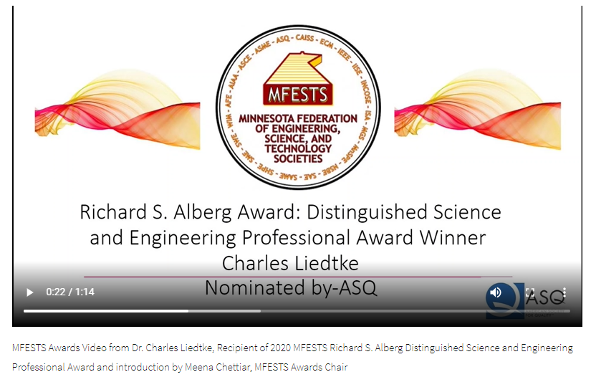
Executive Committee Leadership
(Just highlighting a few examples)
MN State Affiliate Member Engagement
Professional Development/Calendar
Awards

Slide 7
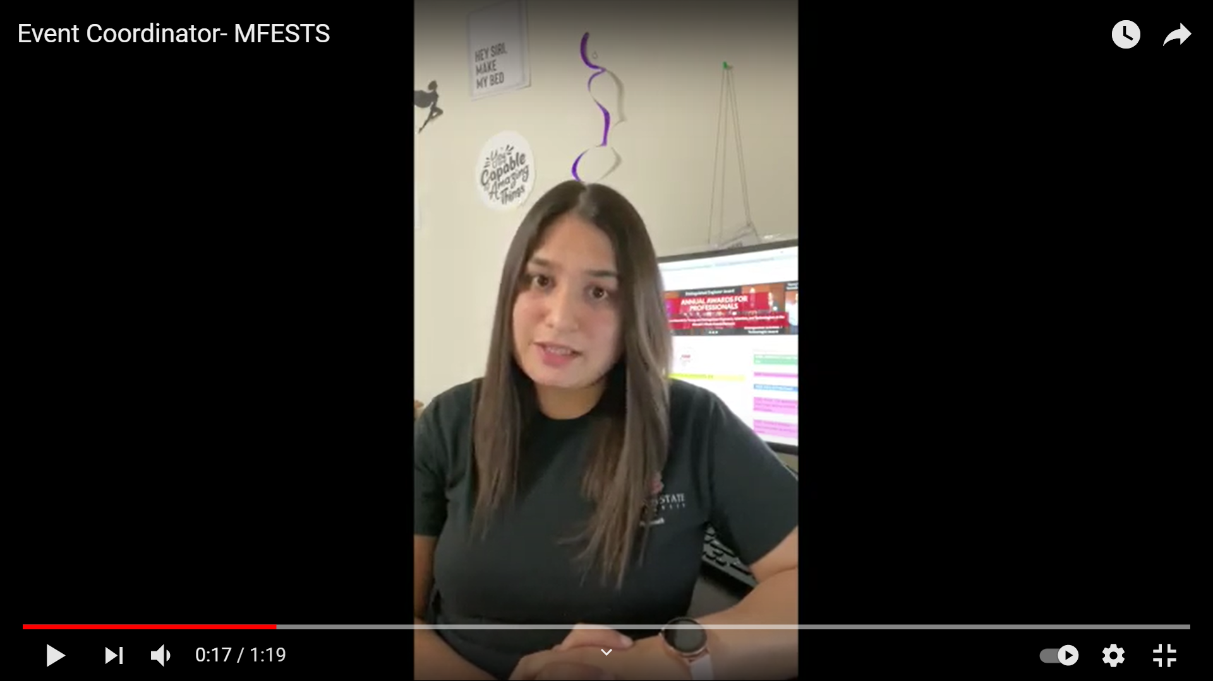
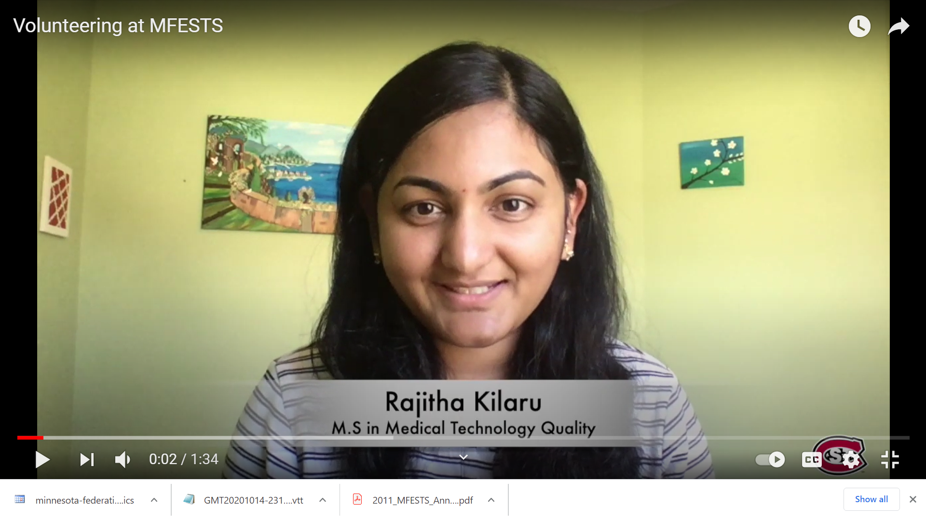
Executive Committee Leadership
2020 Scholarship Awardees
Rishu Rathee
“this opportunity has helped me in strengthening my past skills and developing new skills like working on a project management platform i.e. Freedcamp. “
Youtube Video Link:
https://www.youtube.com/watch?v=h-901Lhe1Zg
Rajitha Kilaru
“with no industry experience and considering a new career, I was looking for volunteering opportunities where I get a chance to learn and grow my connections”
Youtube Video Link:
https://youtu.be/ZAXiUQsjCTk

Slide 8






2021 MFESTS
18 Member Society +
MN State Strong
MFESTS – Current President
Insert your Hands Here
Cathy Krier 763-496-6085
president@MFESTS.org
https://www.mfests.org/

